Slide 1
繰り込み法を用いたX線光電子分光の数値計算
物理学教室セミナー
(令和6年12月13日)

Slide 2
自己紹介
2018年4月: 富山大学理学部物理学科入学
2022年3月: 卒業
2022年4月:富山大学理工学研究科物理学・応用物理学専攻入学
2022年8月: 中退、ヨーロッパへ留学
2024年9月: フランスレンヌ大学＆ドイツLMU修了

Slide 3
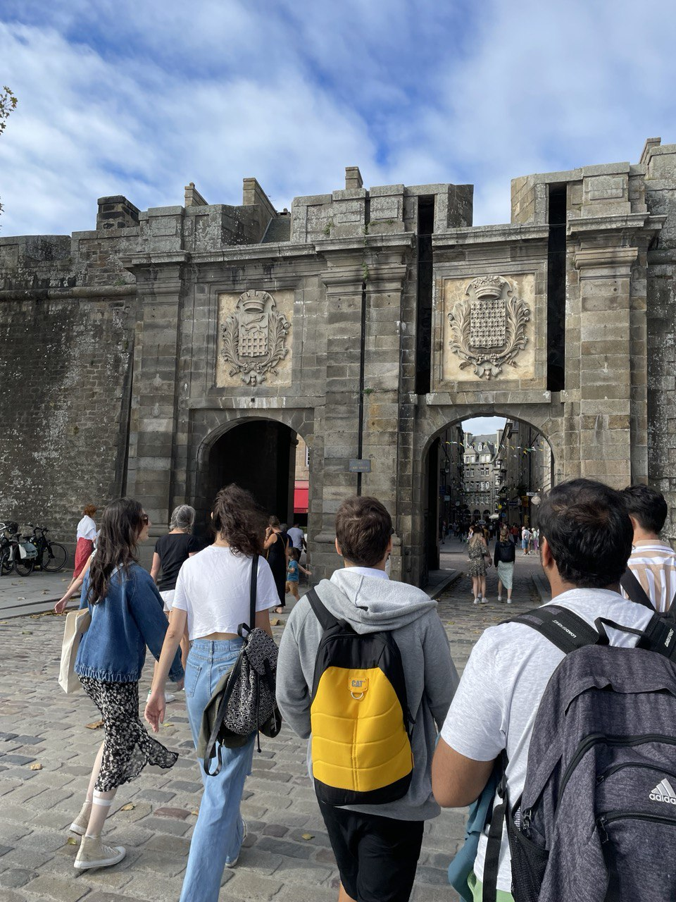
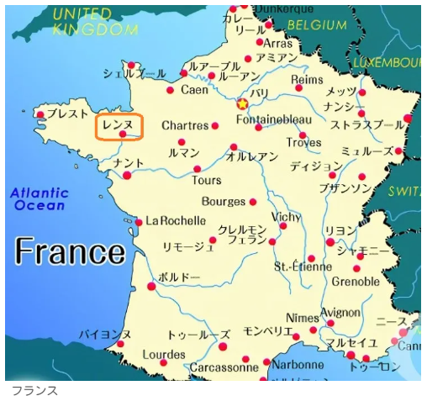
Rennesとは
引用元:https://tetsutaroweb.com/rennes/

Slide 4
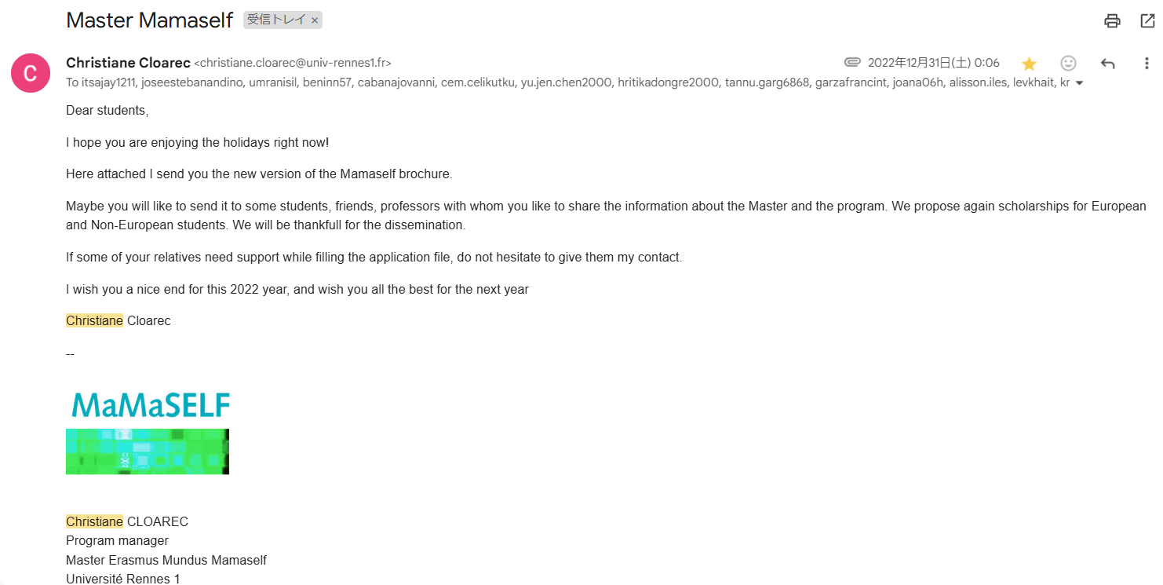
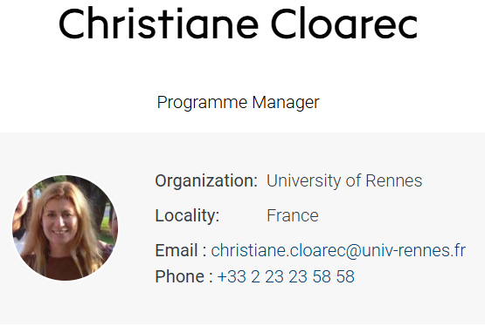
ある人からの依頼

Slide 5

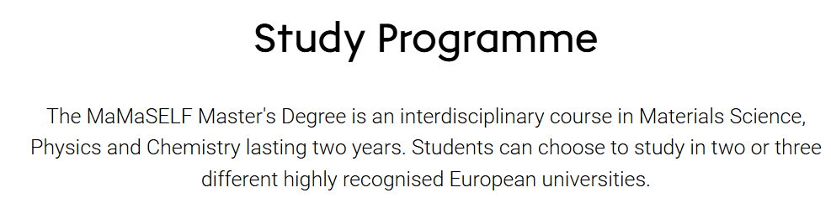

留学プログラム

Slide 6

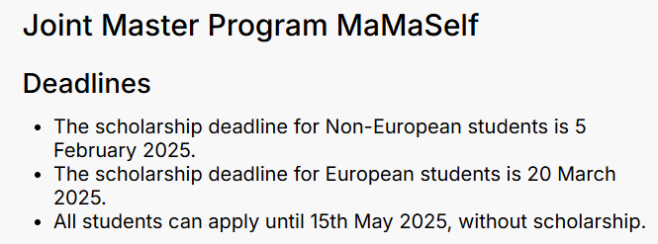
どんな人にもチャンスあり
興味があれば、畑田研究室の安田 新まで: d24c8201@ems.u-toyama.ac.jp
応募の仕方、留学生活・英語の相談、なんでも歓迎します。

Slide 7
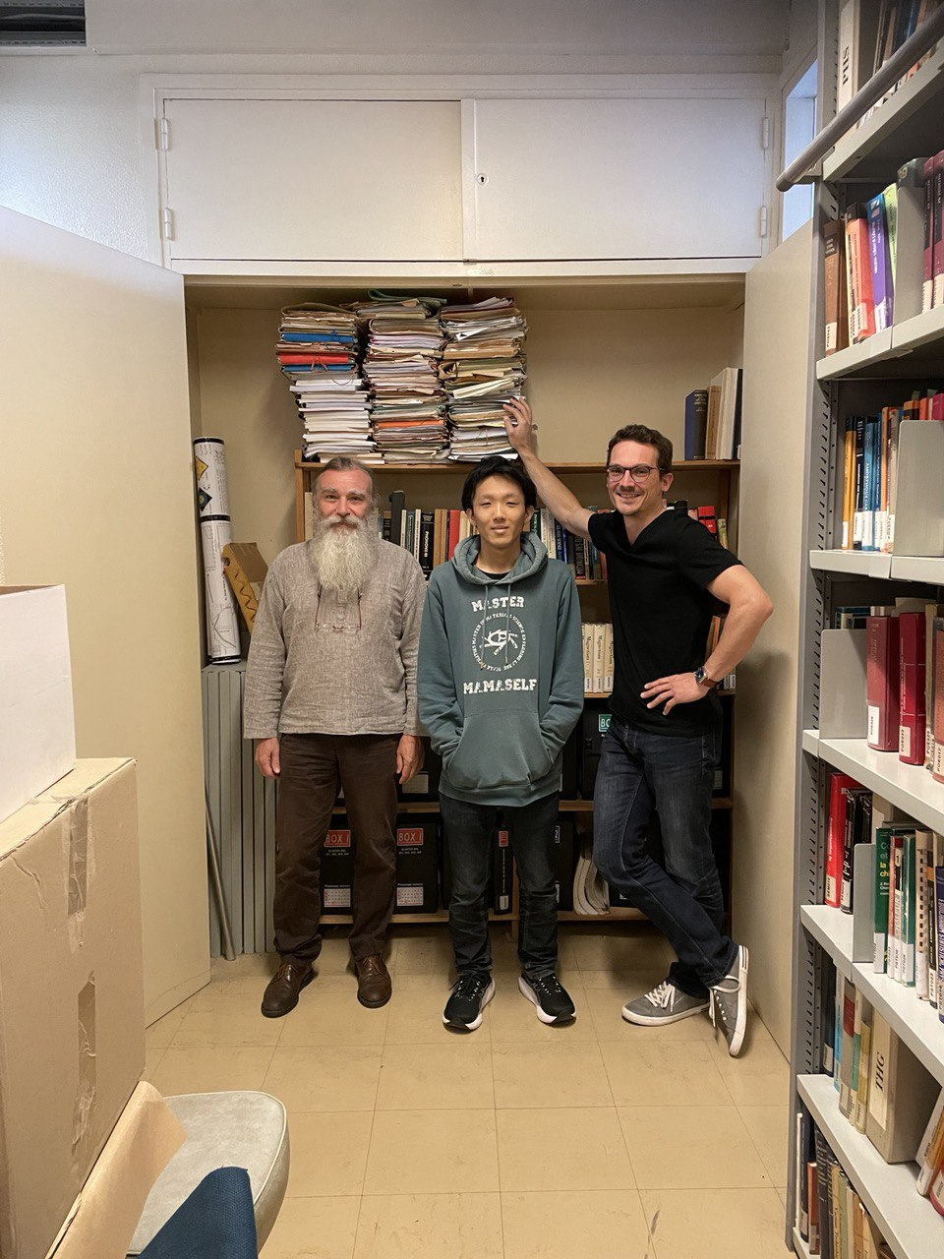
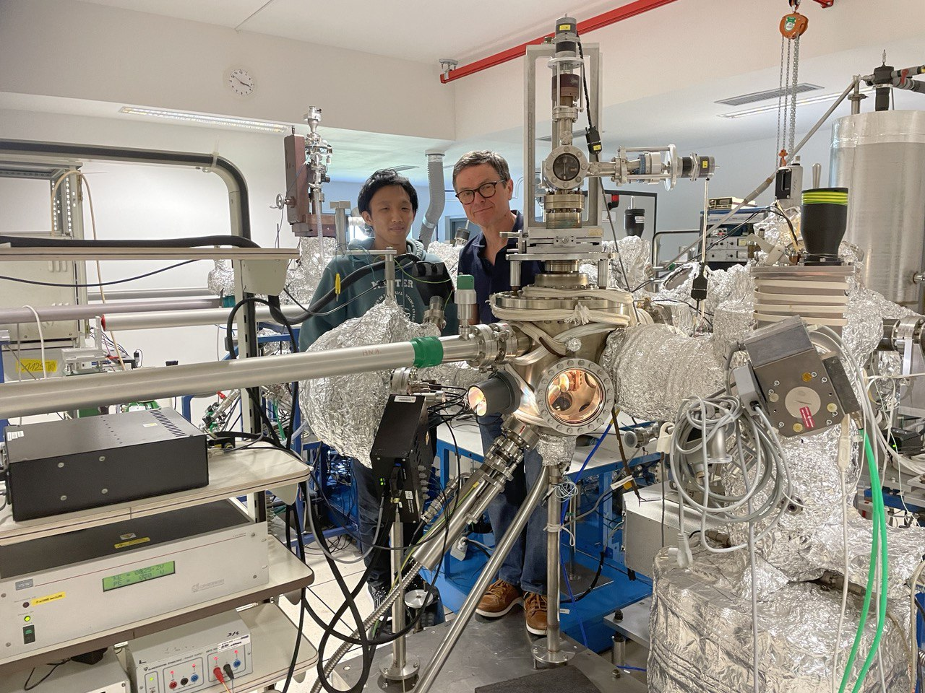
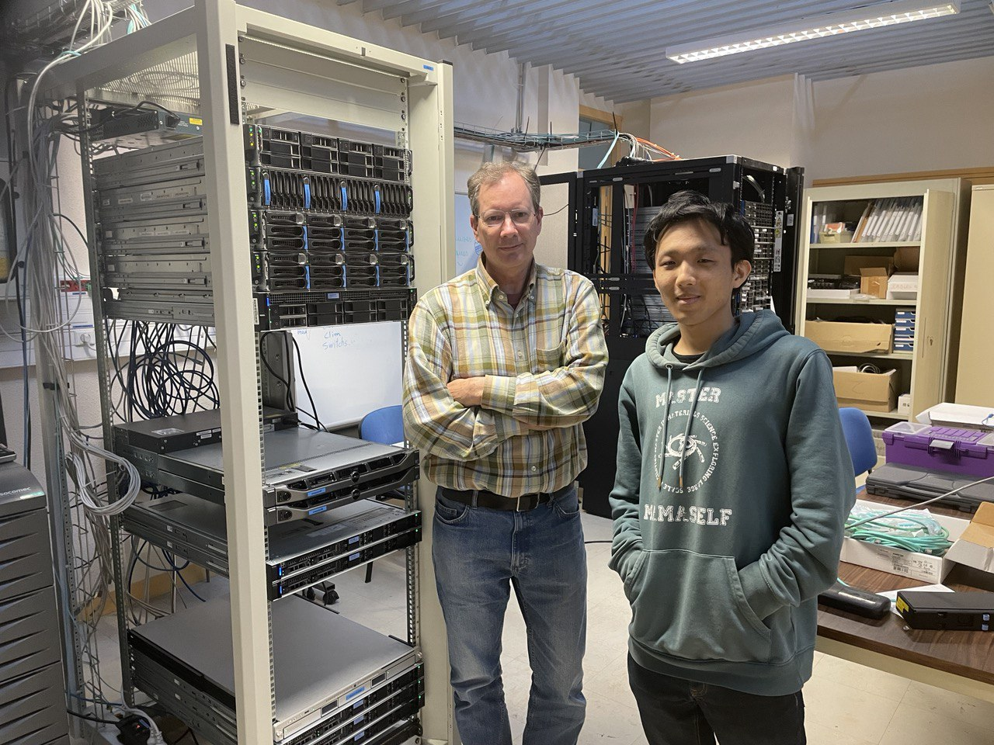
研究の話
場所: Rennes大学

Slide 8
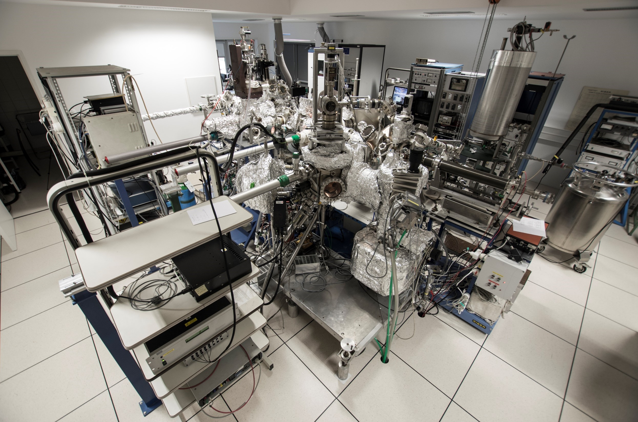
実験設備

Slide 9
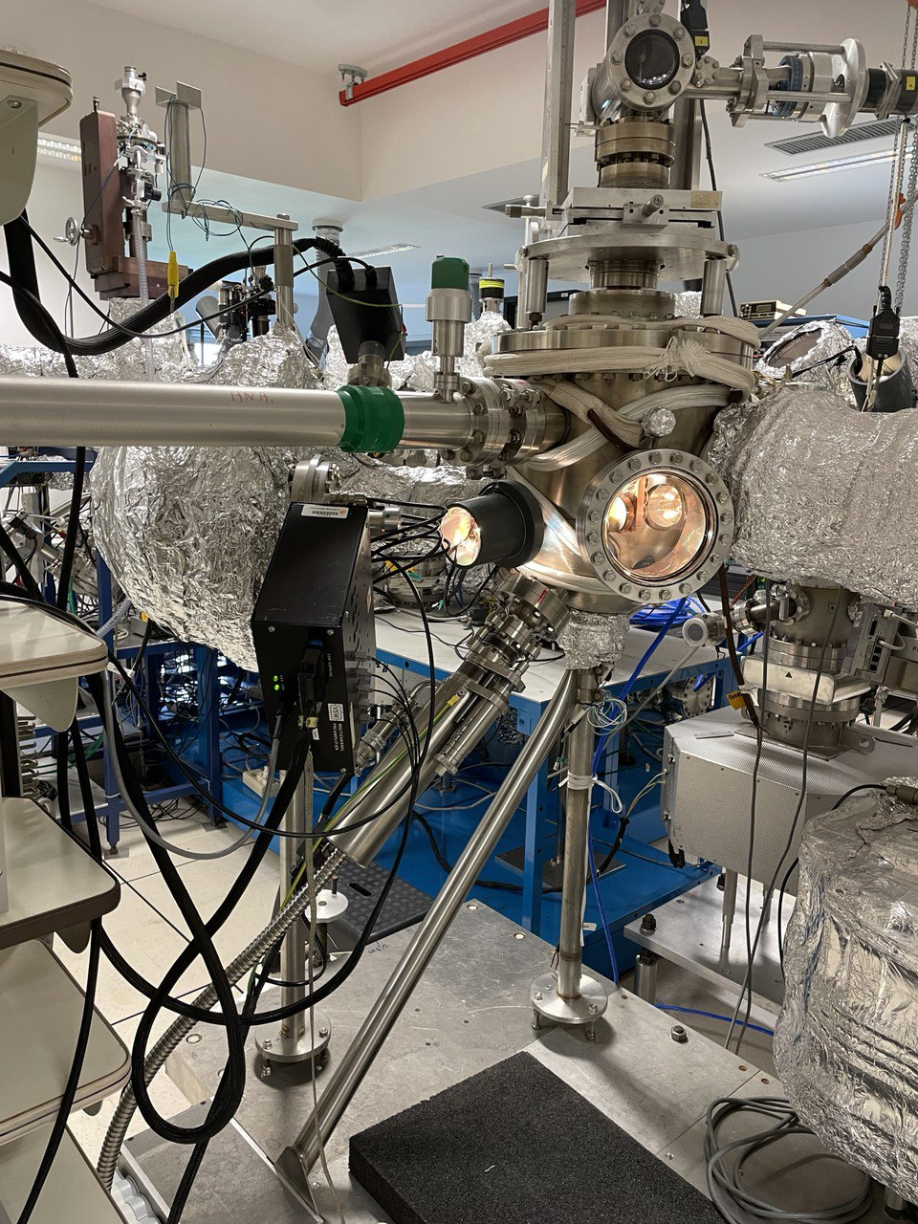
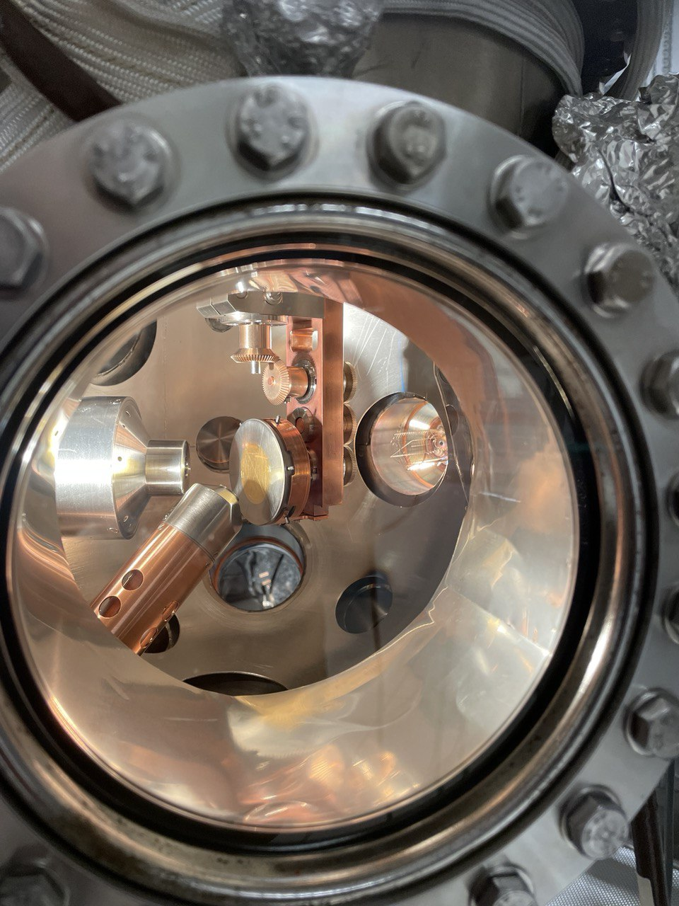
実験設備
φ
Analyzer
θ
X-ray source

Slide 10
今日伝えたいこと ~物性物理の面白さ
物性物理の世界は多様で面白い
Prof. Steven H. Simon (Youtube: 「The Oxford Solid State Basics – Prof. Steven H. Simon」)
Why do we study Condensed Matter Physics ?
1. It is the world
2. It is useful
3. It is deep
E.g.: (Discovery of Higgs-boson, in the paper where he has been awarded the Novel prize, it says:
「I got this idea from Condensed Matter Physicists.」)
4. Anti-reductionism
5. Laboratory + for Quantum and Statistical Mechanics

Slide 11
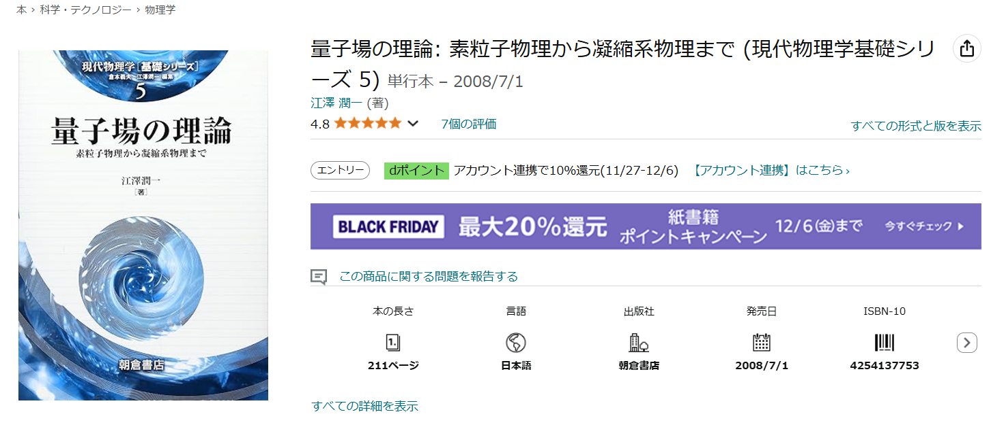
今日伝えたいこと ~ある本の紹介
前書きより抜粋し、意訳したもの:
「素粒子物理学にはひとつしか宇宙がないが、凝縮系物理にはいくつも宇宙がある。」

Slide 12
^{今回の私たちのターゲット: SrTiO3}
ペロブスカイトの微細な構造変化が興味深い性質を引き起こす。
ペロブスカイトは技術的に重要視されている (抵抗スイッチ,青色光発光,光触媒, 2次元電子ガス模型…)
このような性質を理解し、制御するために:
正確な結晶構造の情報,
化学的分解能,
表面感度
E.g.: 2次元電子ガス模型
Oxygen vacancies (V_{O})
SrTiO₃
Fe
Sr
FeO + Fe
Ti
V_{O}
O
SrTiO_{3-x}
[001]
[010]
[001]
[100]
3,905 Å
[010]
[100]
Notes:
So as in the topic.
We are interested in the perovskites esp, Strontium Titanium Oxygen, or STO, because small changes in its structure are responsible for essential properties.
And it is of great technological importance.
The unit cell is a face-centred one, where we have 8 Srs at each vortex, 6 Oxygen at each centre of the faces and 1 Titanium in the centre.
Here is an example of 2-dimensional electron gas formation.
Firstly, on the left we have the iron and the STO layer and interface.
Secondly, oxygen migrates to the iron layer and we have oxidised irons and oxygen vacancies.
And if you look at the unit cell on the right, we have an oxygen vacancy and it causes the titanium to deviate upwards.
However, to understand and control such a property we need accurate crystallographic information, chemical resolution and surface sensitivity and the best way to do that is with X-ray photoelectron diffraction, called XPD.

Slide 13
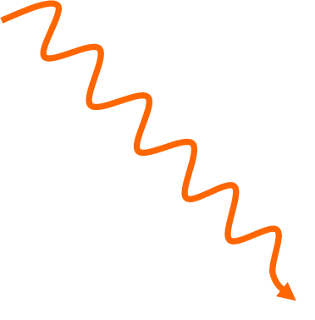

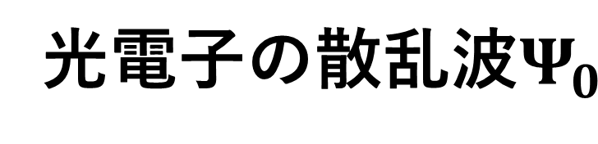
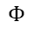
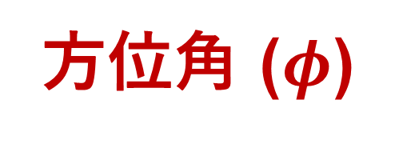
^{X線光電子分光とは ?}
方位角 ($φ$)
極角($θ$)
X線
検出器
運動エネルギー
光電子
0
E_{vacuum}
0
$$Φ$$
仕事関数
E_{Fermi}
BV
光電子の散乱波$Ψ_{0}$
3s
2p
2s
1s
結合エネルギー
Notes:
We need to understand the principle of XPD.
When the sample is rotated along the normal to the surface, we talk about an azimuthal spectrum and otherwise of a polar spectrum.
In the following, we will only deal with polar spectra.
Didier: The photoelectron gathers crystallographic information by repeated scatterings with atoms along its way out.

Slide 14
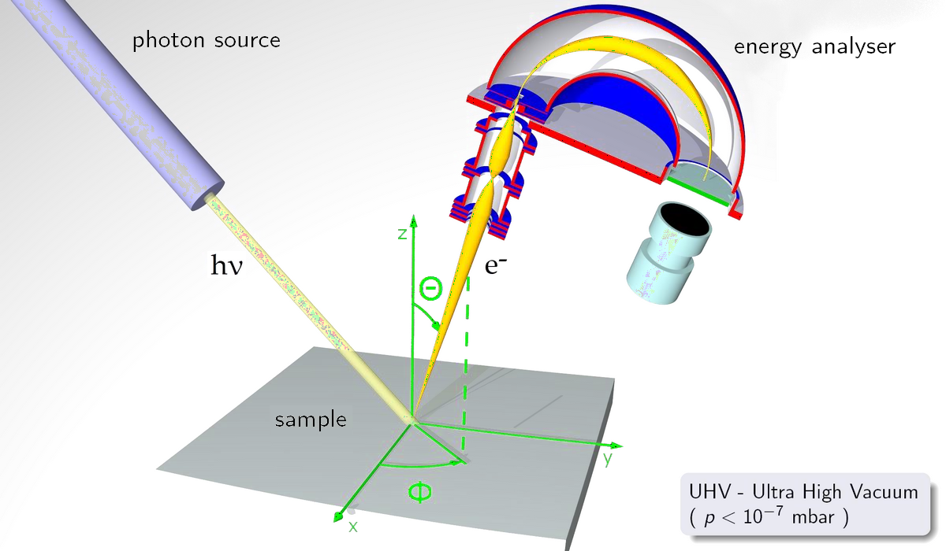
Image from Didier Sébilleau

Slide 15
^{実験とシミュレーションの比較}
なぜ実験とシミュレーションの比較をするのか ?
実験で得られるスペクトルに求める構造の情報が全て含まれている。しかし、それをスペクトルから抽出する方法がない。
構造の情報は、実験スペクトルと理論モデルの比較によってのみ正確に抽出できる。
理論的枠組み:多重散乱理論
実空間での話 (k-空間ではない)
Notes:
Going further, it is valuable to compare experimental and simulation results.
The first reason is that all the information we seek is in the spectrum, but we have no direct way to retrieve it.
And this information can only be accurately extracted by comparison with a theoretical model, which is in the framework of multiscattering theory.

Slide 16
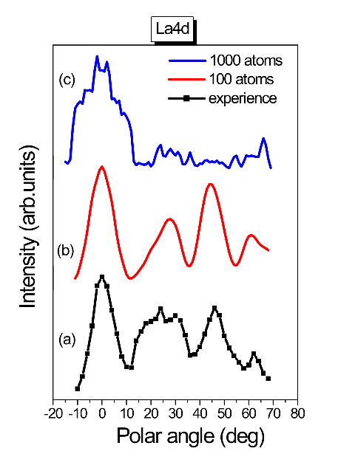
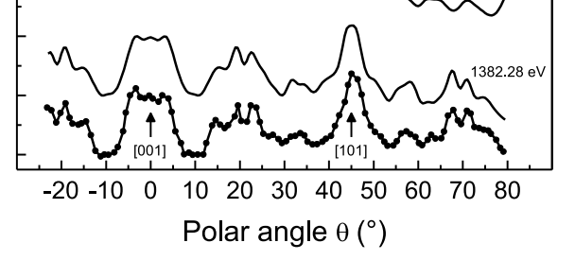

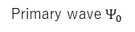
E.g: シミュレーションの課題 ~ Si vs LAO (LaAlO3⁾
Si(2p) in Si(001) substrate
La(4d) in LaAlO₃
Peaks of intensity along dense atomic directions
Polar scan of Si(2p) in Si(001) substrate
X-ray
Surface
[001]
[101]
Simulation needed for complete interpretation and quantitative information
Primary wave $Ψ_{0}$
S. Tricot, T. Jaouen, D. Sébilleau, P. Schieffer, J. Electron. Spectrosc., 256, 147176 (2022)
Fig. 2: PED calculation for LaAlO₃ (Mohamed Zanouni, Faculty of Sciences, Tangiers, Morocco)
実験とシミュレーションは一致 !
全く一致しない !
発散はどこから来るのか ? どうやって解消するのか ?
Notes:
This is an example of the comparison.
On the left we have polar scans of the silicon 001 substrate.
The thick line is from an experiment so we have the main peaks corresponding to dense atomic directions.
And the smooth one is simulation.
Obviously we have excellent agreement between them.
On the other hand, we have a problem with the Lanthanum Alminum Oxygen. This is one of the perovskites.
Here the black line is an experiment and the red one is a simulation with 100 atoms.
In red we have almost a good fit to the experiment, but we are missing fine peaks in black.
So when we go to 1000 atoms in blue, some unwanted peaks appear.
We call these peaks divergences.
So now the question is "where does divergence come from and how can we cure it?

Slide 17
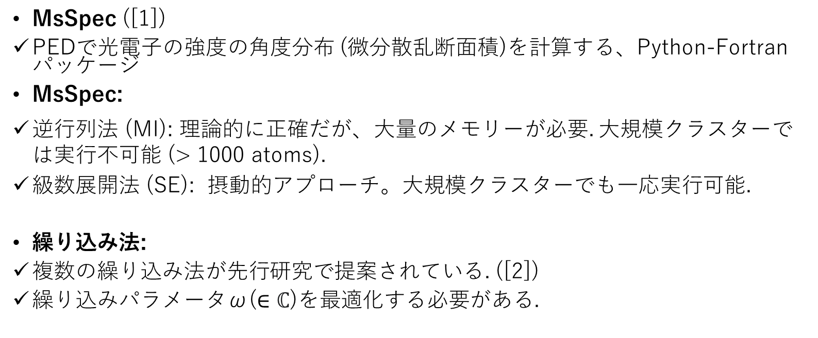
^{数値計算コード: MsSpec}
MsSpec ([1])
PEDで光電子の強度の角度分布 (微分散乱断面積)を計算する、Python-Fortranパッケージ
MsSpec:
逆行列法 (MI): 理論的に正確だが、大量のメモリーが必要. 大規模クラスターでは実行不可能 (> 1000 atoms).
級数展開法 (SE): 摂動的アプローチ。大規模クラスターでも一応実行可能.
繰り込み法:
複数の繰り込み法が先行研究で提案されている. ([2])
繰り込みパラメータω($∈\text{ℂ}$)を最適化する必要がある.
発散が起きたら…
[1] Website of MsSpec: https://msspec.cnrs.fr/index.html
[2] Takatsu, A. et al., Simple renormalization schemes for multiple scattering series expansions, Phys. Chem. Chem. 24 5658–5668 (2022)
Notes:
To answer the questions, we are working on a specific package called MsSpec.
The matrix inversion is an exact solution in theory and should be the same as what we get from experiments.
SE: Perturbative means that it might have divergence.
On the arrow animation: When it is not applicable, we use renormalisation methods.

Slide 18
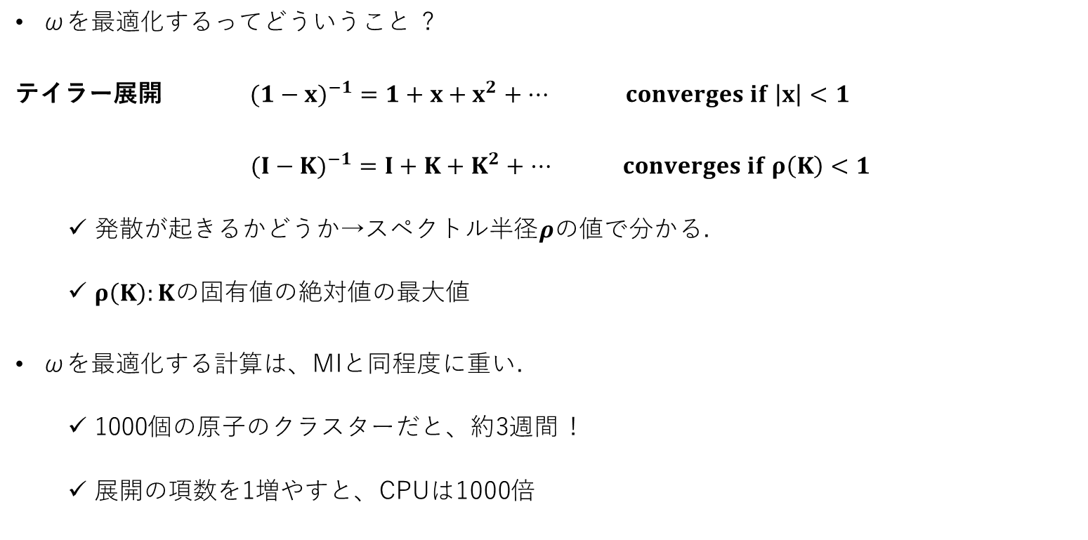
^{ωの計算}
ωを最適化するってどういうこと ?
テイラー展開 $({1−x)}^{−1}=1+x+x^{2}+… converges if \left|x\right|<1$
$({I−K)}^{−1}=I+{K+K}^{2}+… converges if ρ\left(K\right)<1$
発散が起きるかどうか→スペクトル半径$ρの$値で分かる.
$ρ\left(K\right):K$の固有値の絶対値の最大値
ωを最適化する計算は、MIと同程度に重い.
1000個の原子のクラスターだと、約3週間 !
展開の項数を1増やすと、CPUは1000倍
発散は1次元の原子鎖から来ていることを発見
Notes:
Ok, we need to optimise the omega parameter to avoid the divergence.
Here is the proucess.
If we have something like (1-x)-1, it is easy to expand it in series like .....
And we know that it converges when...,.
In the codes, we have similar one in a matrix form except the convergence where the largest eigenvalue in the modulus <1.
We call it spectral radius which is ρ.
But All eigenvalues are calculated to get spectral radius so the calculation is as heavy as the MI.
For example, it takes about 3 weeks for 1000 atoms.
And in this expansion, if we increase the order of the expansion by 1, the CPU time is multiplied by 1000 in the case where we have 1000 atoms.
We have discovered that the divergence comes from atomic chains, which are easier to analyse than large clusters.

Slide 19
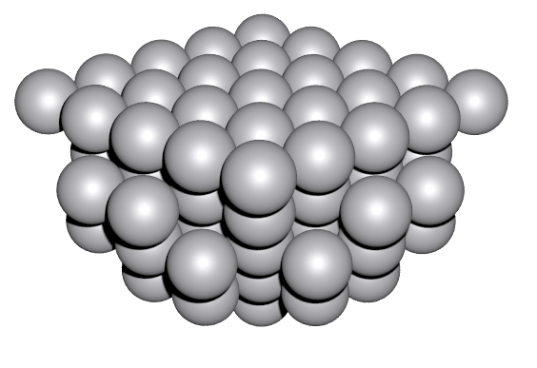

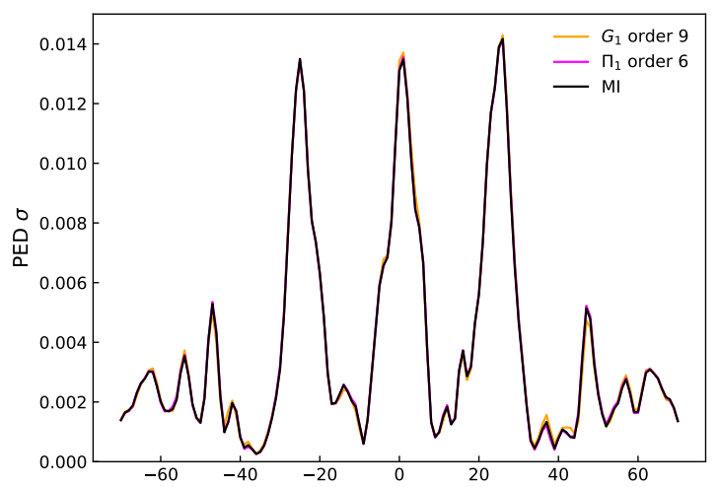
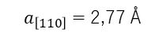
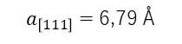
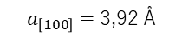

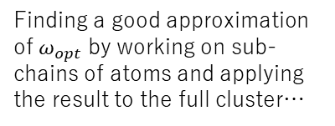
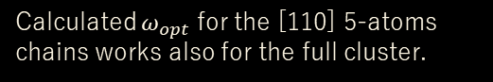
^{原子鎖を用いた方法論}
方法論: 高密度の原子鎖に対してωを計算し、その値をクラスターの計算に用いる.
E,g.: 84個のPt原子のクラスター
84 atoms cluster of Pt
$ρ\left(K\right)$= 1,09 @ 410 eV
Pt
Emitter atom
*MIの計算が可能→方法論との比較ができる
Finding a good approximation of $ω_{opt}$ by working on sub-chains of atoms and applying the result to the full cluster…
Calculated $ω_{opt}$ for the [110] 5-atoms chains works also for the full cluster.
G₁ order n = 9
Π₁ order n = 6
MI
$a_{\left[111\right]}=$ 6,79 Å
Pt
[001]
Π₁ is faster than G₁
CPU ∝(N_{at}-1)^{n}
[010]
[100]
$a_{\left[110\right]}=$ 2,77 Å
$a_{\left[100\right]}=$ 3,92 Å
Polar angle (degree)
Notes:
Then we have the methodology to calculate ω only for dense atomic chains and then use it for the full cluster.
Here we tested the cluster of a 84 Pt cluster.
Photoelectron kinetic energy is 420eV not high.
But we have the spectral radius above 1 thus it shows divergence. And in this figure, the black is MI with three peaks corresponding to dense atomic chains here.
And the pink and orange are renormalizations which are G and pi by ω from [110] 5 atomic chains.
For G1 and P1, the truncation orders are important because the CPU time is propotional to…
And we see that Pi is faster than G1.
83^9, 6
It is quite early.
How about STO cluster ?
Even the monoatomic cluster had the divergence and STO is a heterostructure.

Slide 20
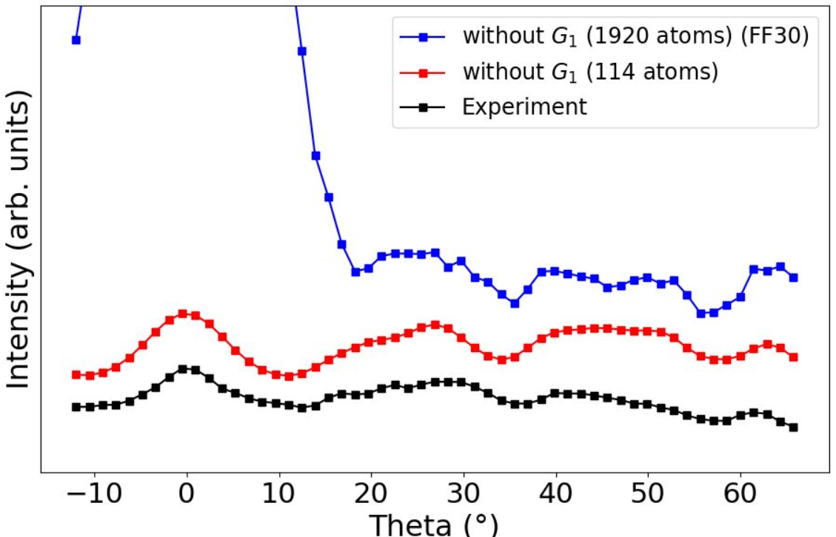
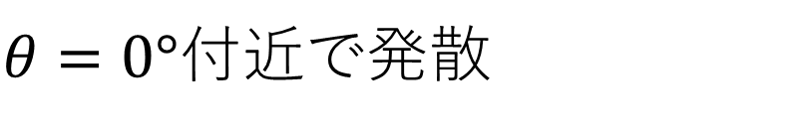
^{STOを考えてみよう}
STOをSEで計算すると;
z
y
x
繰り込み法 (G₁)なし
ここには何がある？
$θ=0°付近で$発散

Slide 21
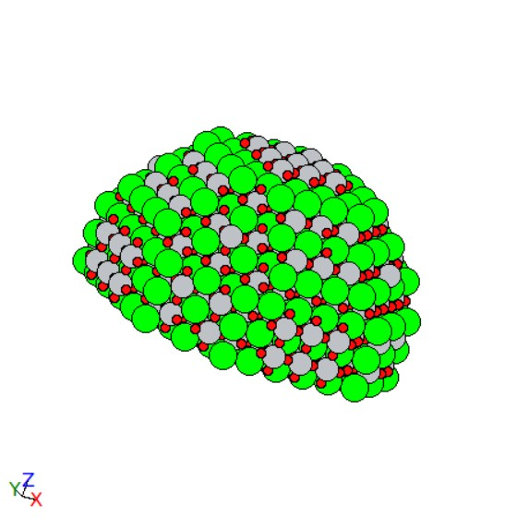
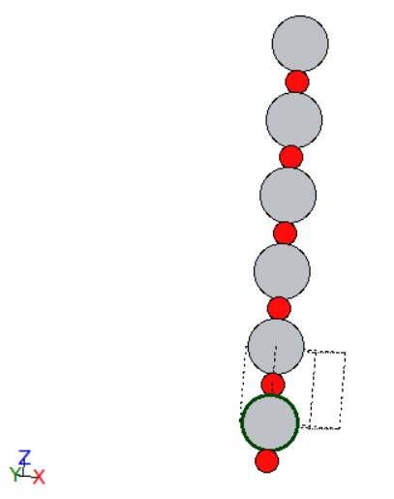
^{原子鎖を用いた方法論 ~ STO}
STO クラスター (Ti emitter, 1019eV)
𝜌_{𝑆𝐸} = 1.135
𝜔 = 0.813 + 0.241𝑗
𝜌_{𝐺1} = 0.706
層数: 12
半球の半径: 21Å
Ti emitter: 下から2番目の層の中心
緑: Sr
グレー: Ti 赤: O

Slide 22
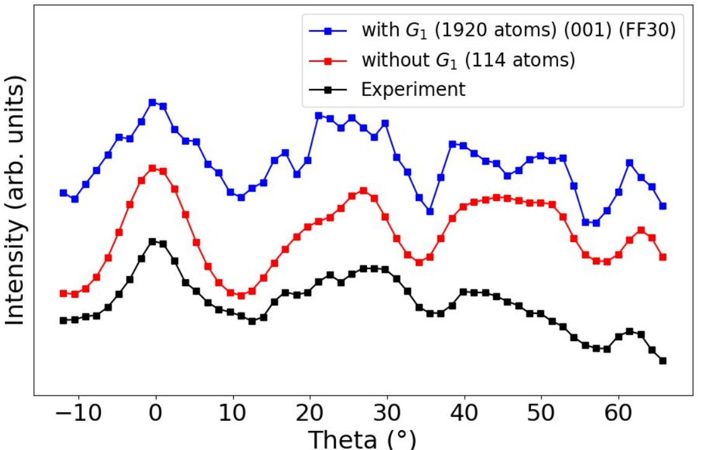
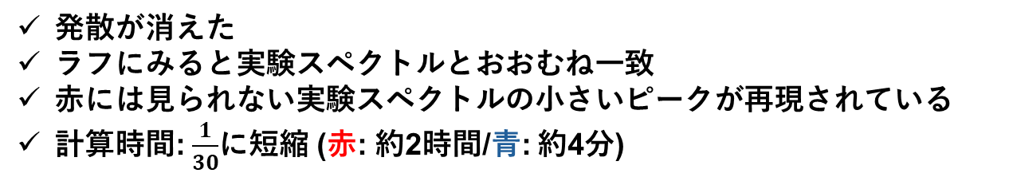
^{結果}
繰り込み法 (G₁)なし
発散が消えた
ラフにみると実験スペクトルとおおむね一致
赤には見られない実験スペクトルの小さいピークが再現されている
計算時間: $\frac{1}{30}$に短縮 (赤: 約2時間/青: 約4分)

Slide 23
^{結果}

Slide 24
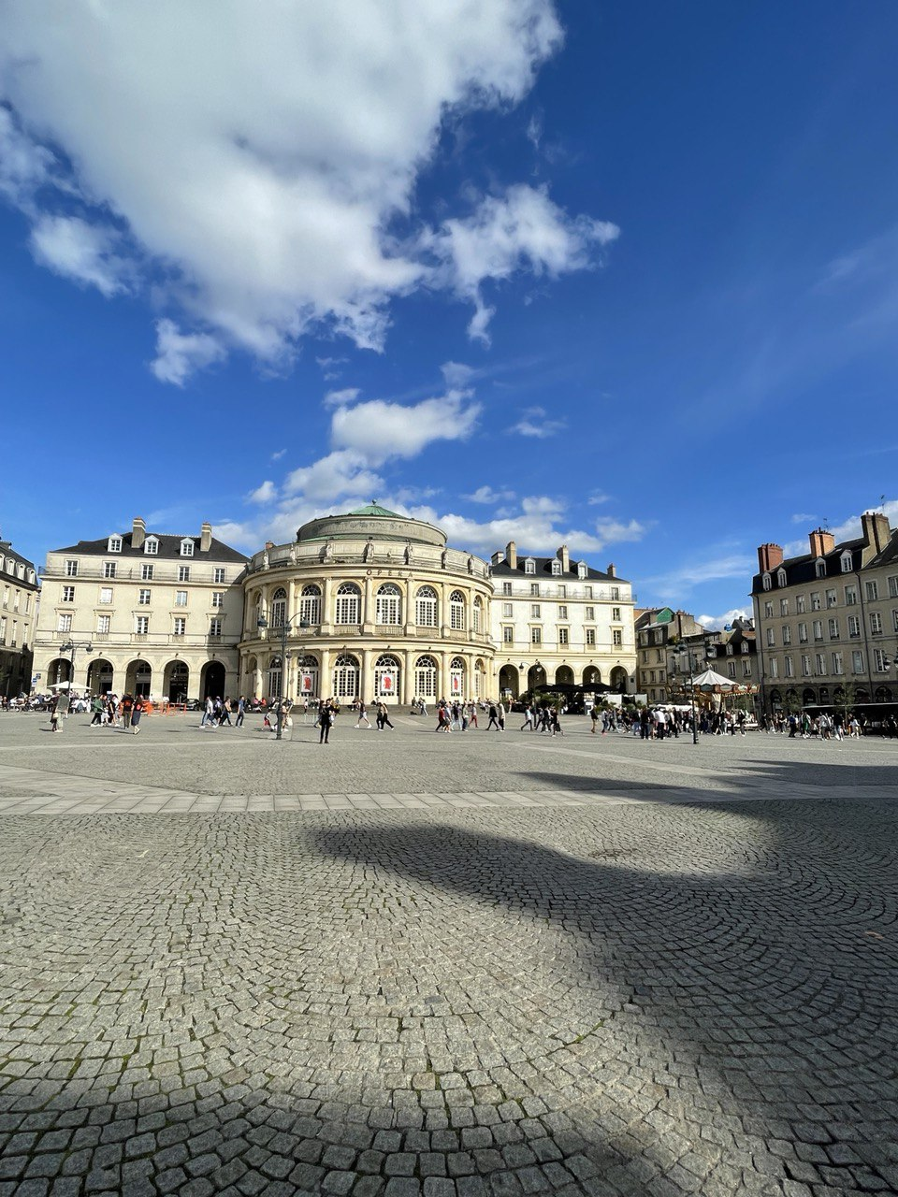
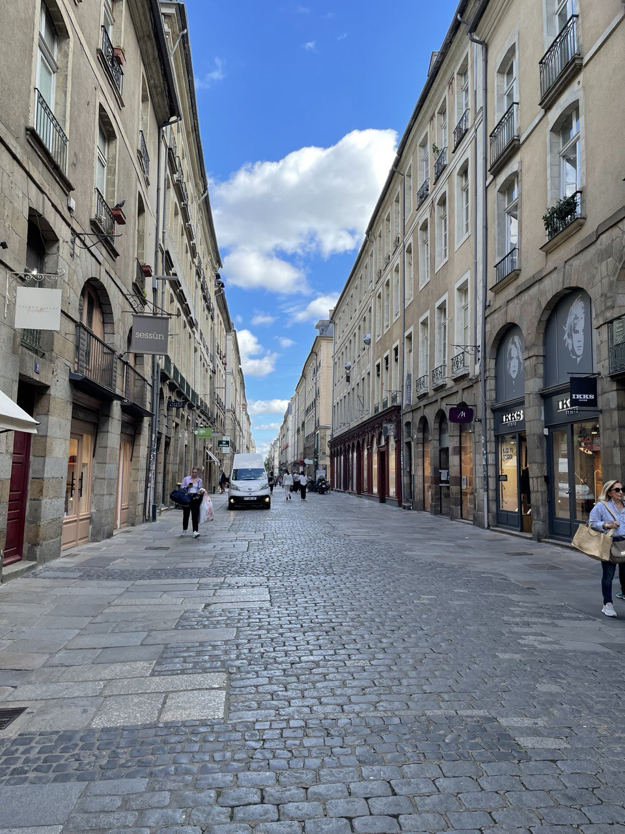
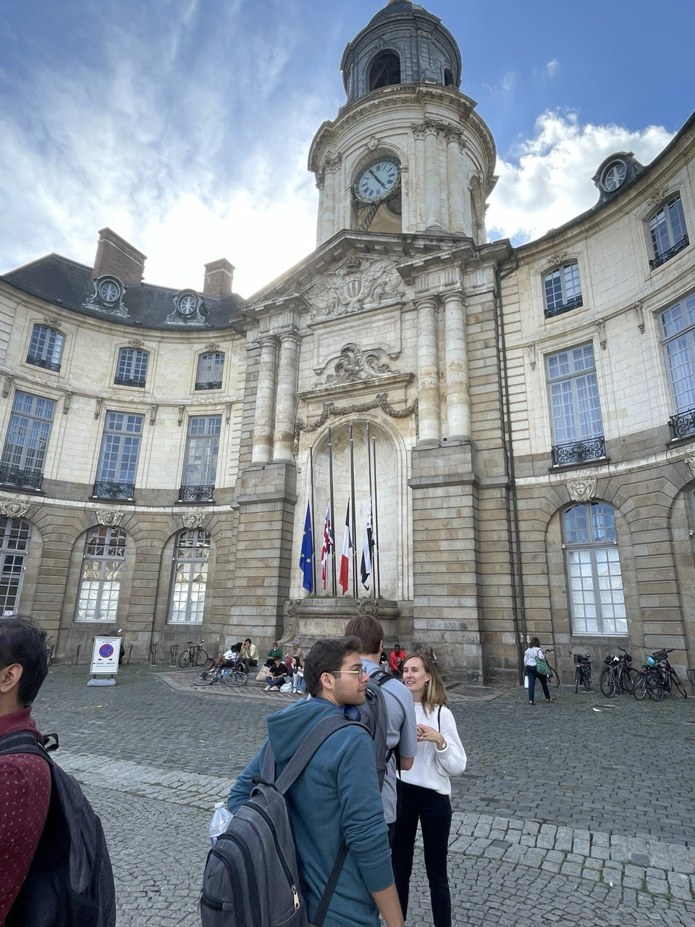
留学生活 Rennesの中心街

Slide 25
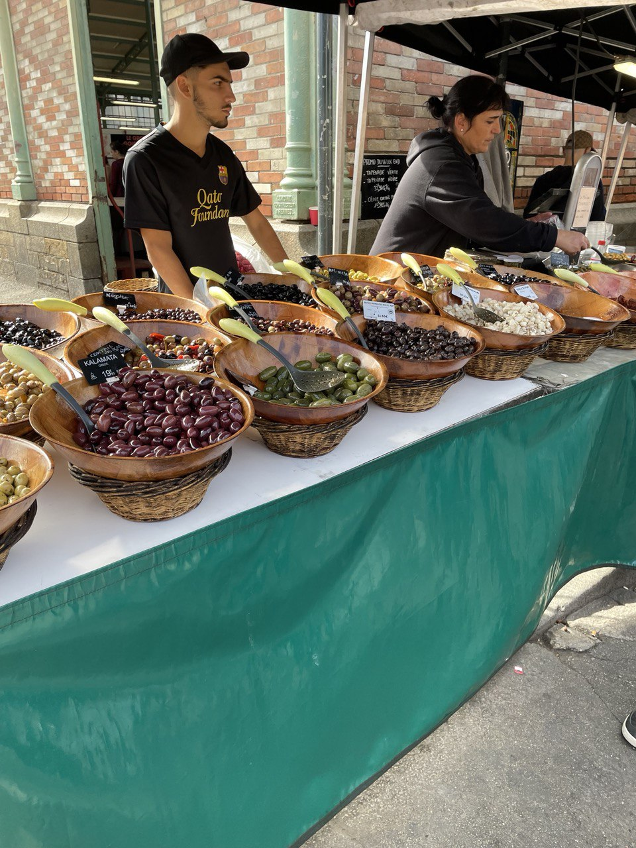
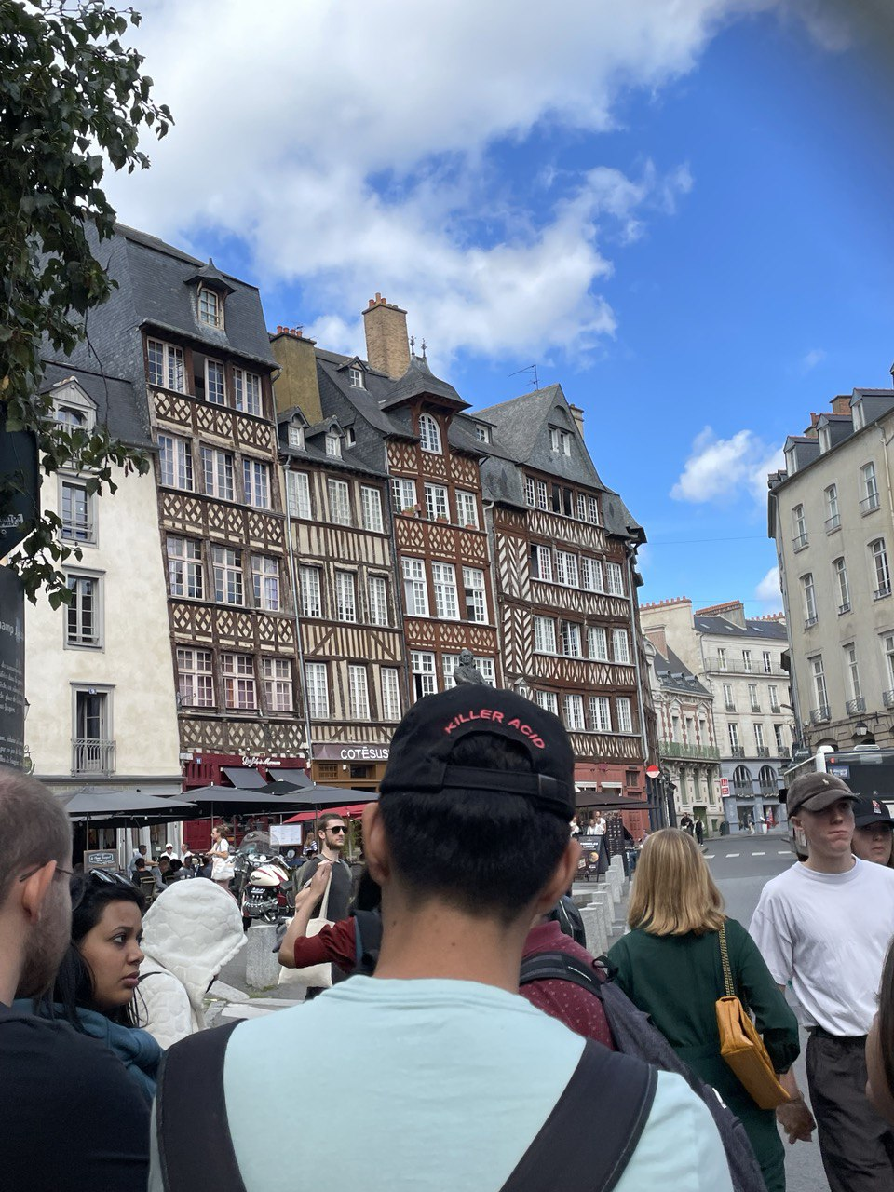
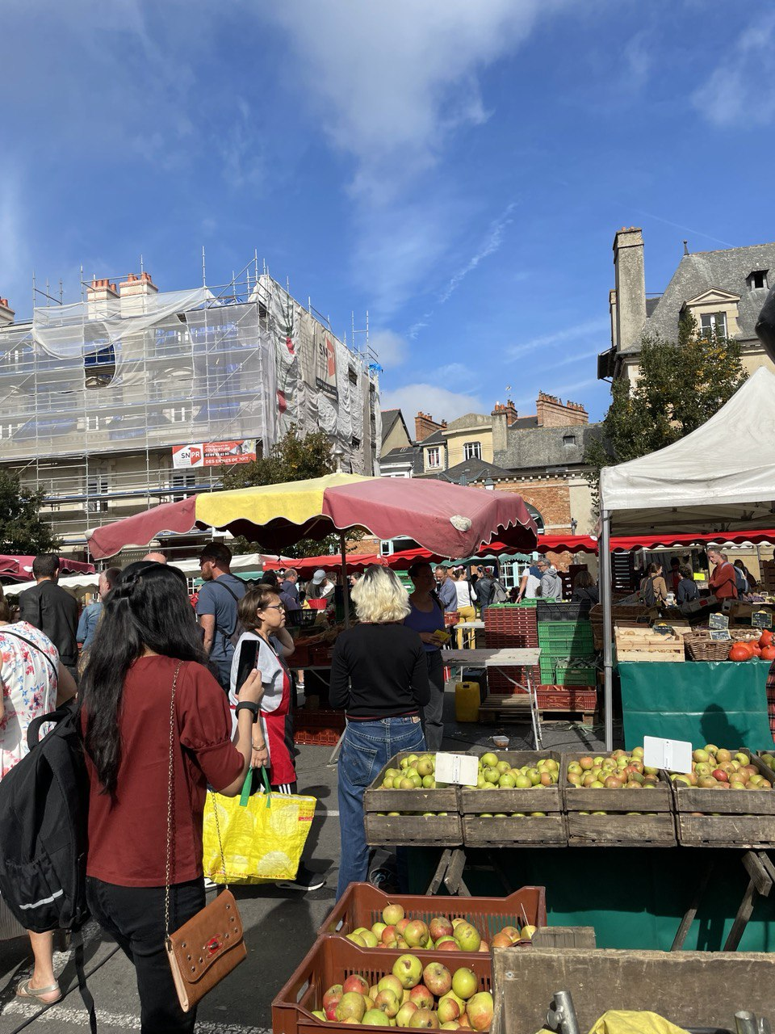
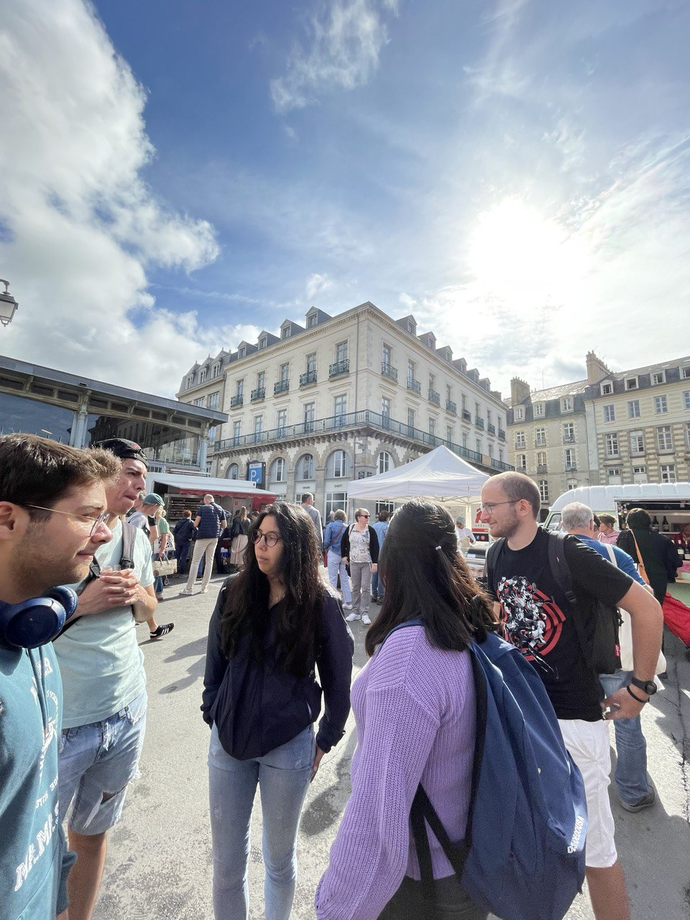
留学生活 Rennesの市場 (土)

Slide 26
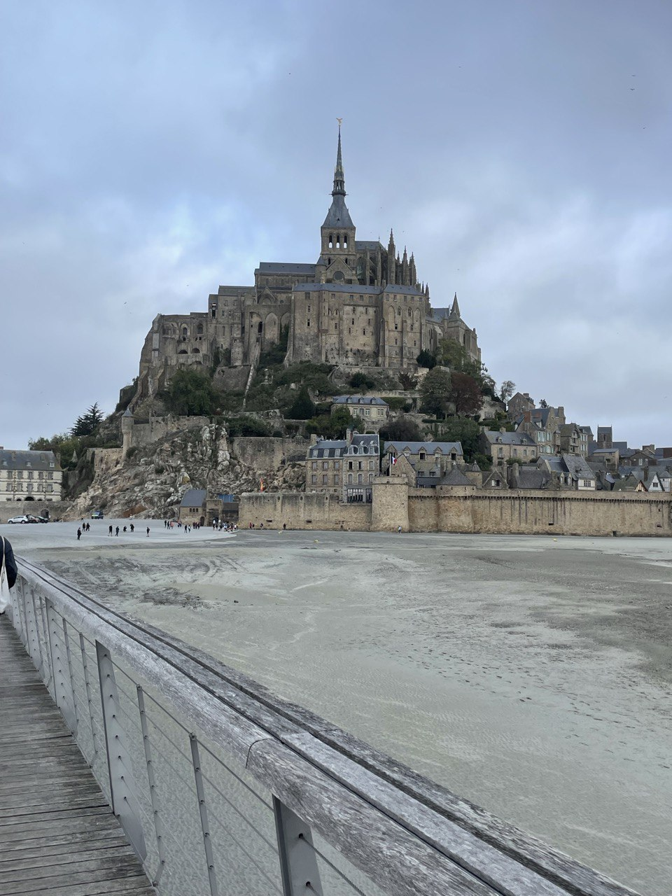
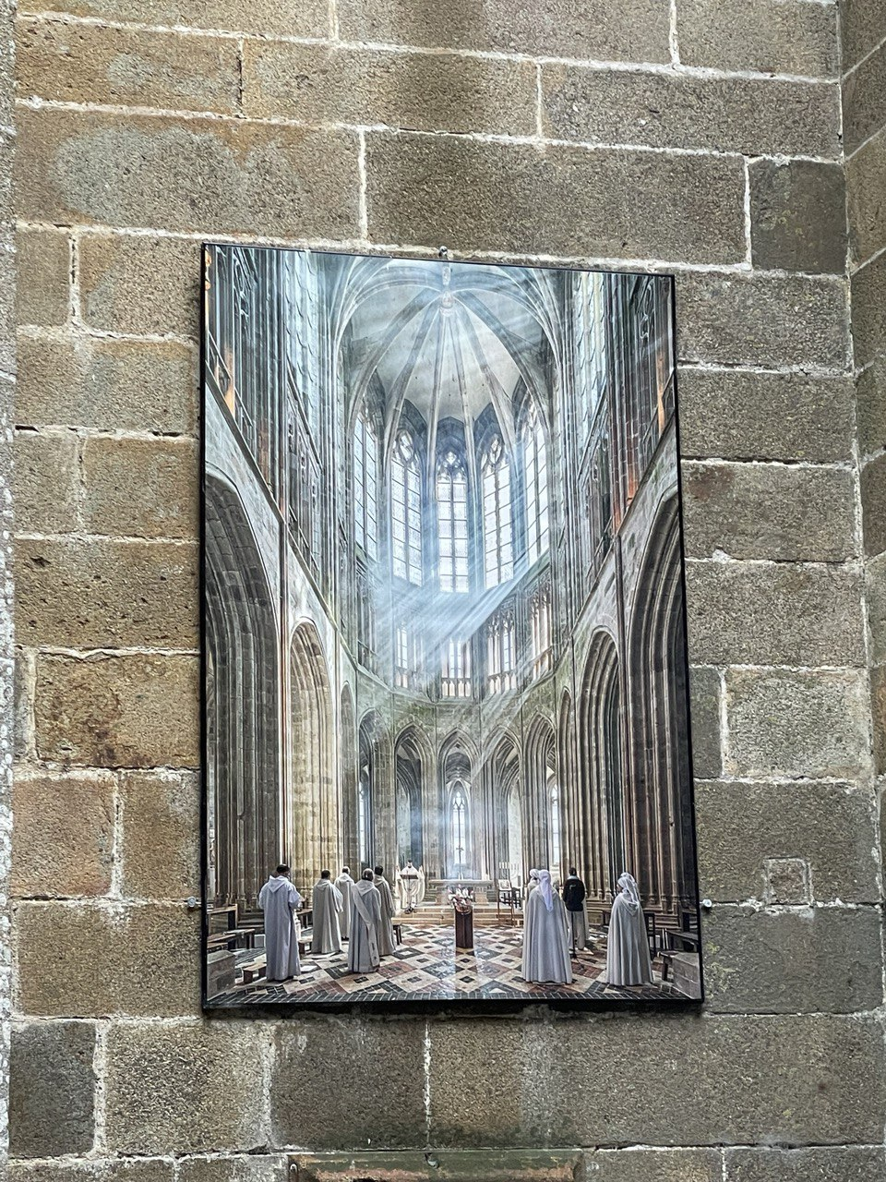
Rennes 世界遺産
引用元:https://tetsutaroweb.com/rennes/

Slide 27
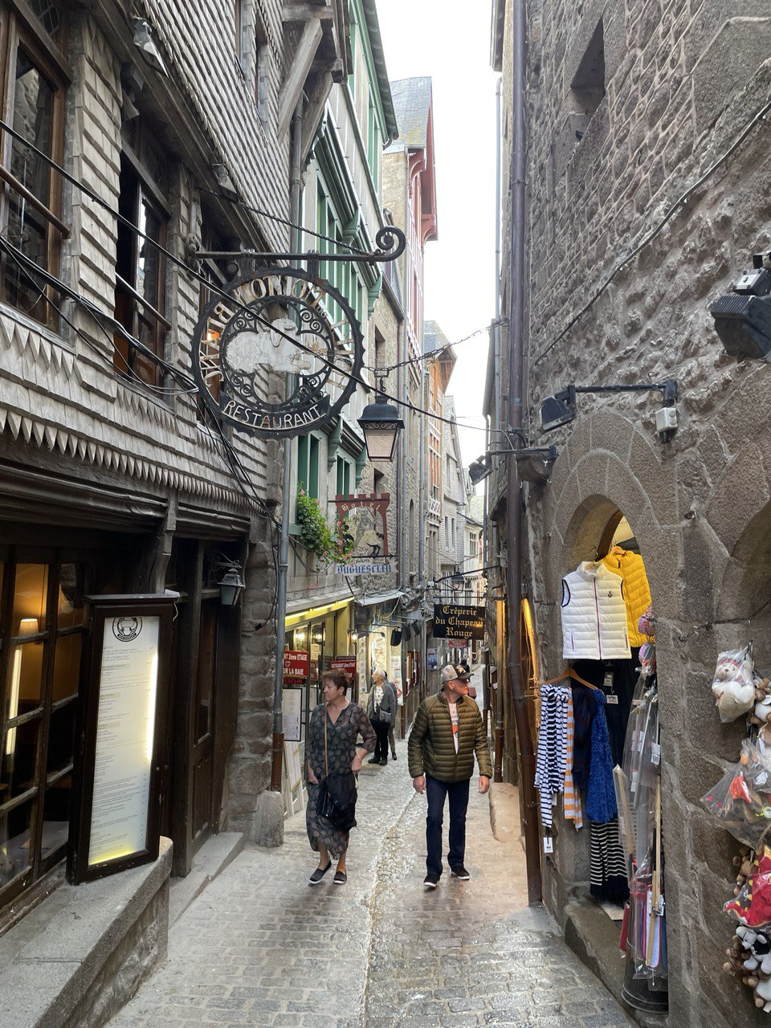
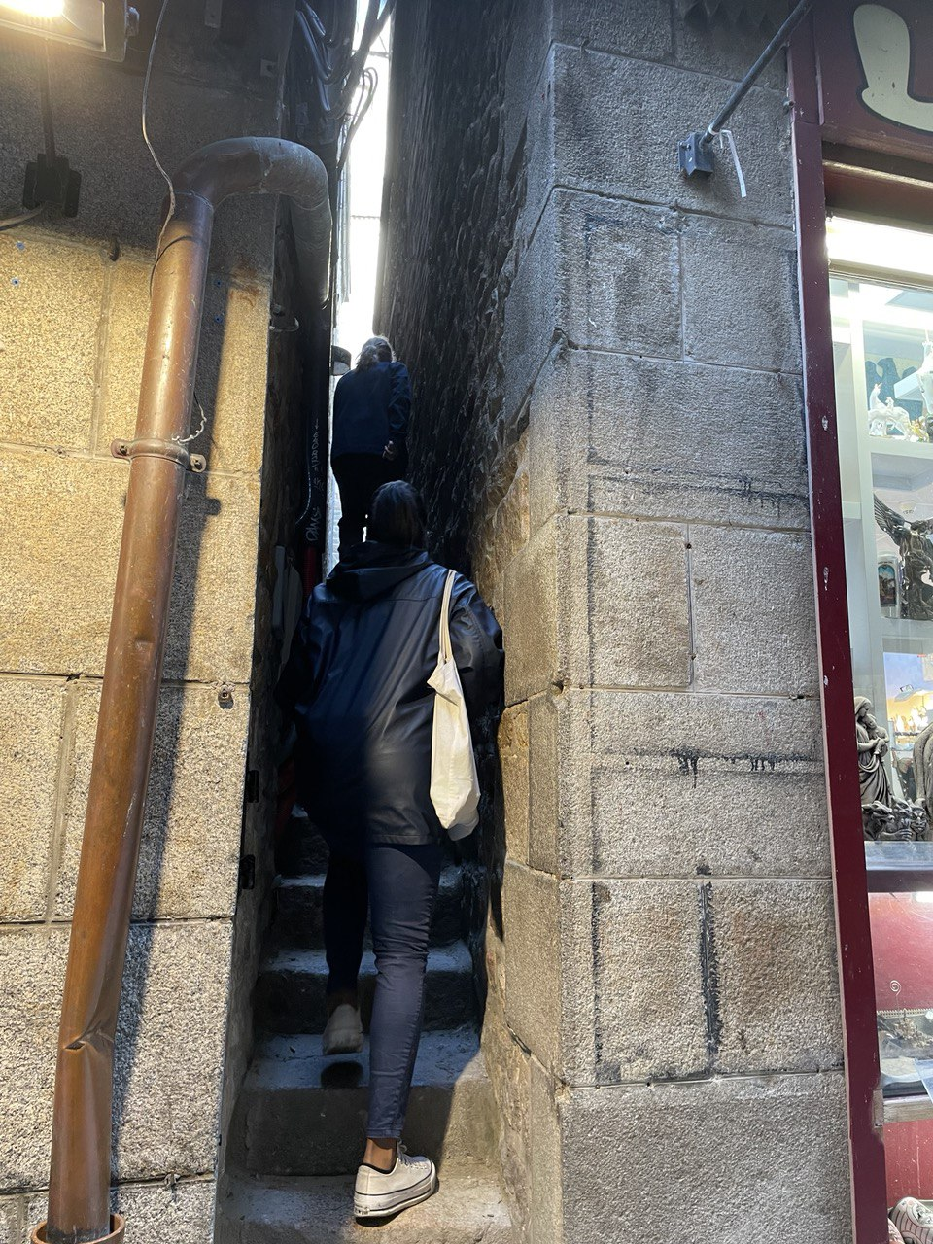
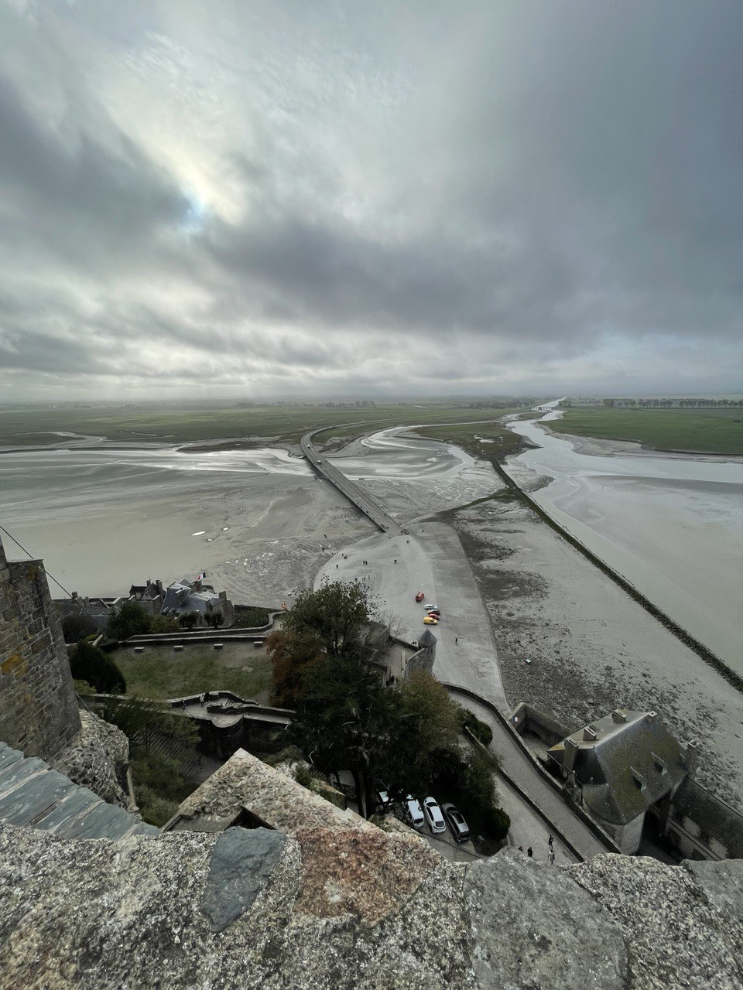
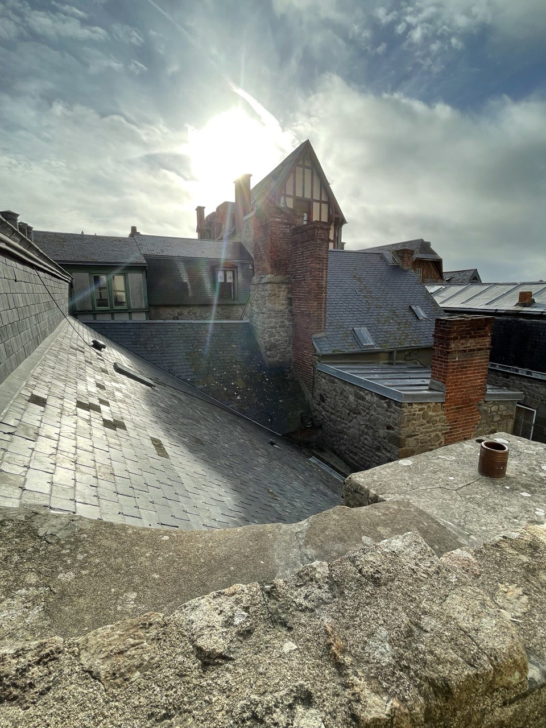
Le Mont-Saint-Michel

Slide 28



Le Mont-Saint-Michel

Slide 29




Rennesの魅力 カトリックのクリスマス

Slide 30




ドイツへの交換留学

Slide 31



ミュンヘンといえば

Slide 32



LMUのキャンパス

Slide 33


キャンパス、建物内

Slide 34



ミュンヘンから外に出ると

Slide 35


TUMの駅

Slide 36
N ~ Nat*(lmax+1)**2
Ek = 40eV, lmax = 4
Ek = 1000eV, lmax = 15
Ek = 8000eV, lmax = 50

Slide 37
^{Issue for STO}
High truncation order of scattering paths
High kinetic energy for photo electron (~1000eV) (lab condition)
Electron Mean Free Path is large (19Å: larger clusters)
High consumption of scattering orders
Sr has higher backscattering factor than Ti and O
Forward scattering factor > lattice parameter
Notes:
The figure of SF for Sr
Remove it work on transition to the next slide with explanation

Slide 38


^{Calculation time}
Calculation time is proportional to the number of paths taken into account (not the atomic species and structure,…purely geometric way !):
E.g.1: 3 Sr atoms, scattering order = 2
X-ray
$$e^{−}$$
0
1
1
0
2
$$e^{−}$$
Some other scatterings taken into account…
Totally…7 !
It doesn’t take even 1 minutes to calculate !

Slide 39

Divergence indicator - Spectral radius -
In PED, we focus on differential cross section. (reflecting the structure of material)
It’s associated with the scattering path operator:
$$τ=T({I−G_{o}T)}^{−1}$$
Physic is easy !
$T$: scattering by individual atom with potential
$G_{0}$: free propagation of an electron from atom to atom
We need to solve the eigenvalue equation of$τ$:
We have to inverse the matrix,$({I−G_{o}T)}^{−1}$→ Matrix inversion method
It is mostly impossible because the matrix size is huge for clusters.

Slide 40

Instead of it:
$${\overline{τ}}^{ji}={\overline{T}}_{i}δ_{ij}+{\overline{T}}_{j}G_{o}{\overline{T}}_{i}+\sum_{k≠i,j}{{\overline{T}}_{j}G_{o}{\overline{T}}_{k}G_{o}{\overline{T}}_{i}}+…$$
This is looking like:
$$({1−x)}^{−1}=1+x+x^{2}+…$$
where x $≅G_{0}T$ (don’t check your math !)
It diverges at $x>1$.
- In this regard, we have divergence if spec$\left(G_{0}T\right)>1;$absolute value of some eigenvalue is above 1.
- We introduce spectral radius:
$$ρ=\max_{λ}{abs(λ)}$$
- Then we may say:
$ρ>1 \underset{⇔}{def}$ (Divergence appears)

Slide 41

Success of Renormalization methods
Mainly, three methods have been proposed and successful to break the divergence !
E,g.: G_1 (approximation at n=1, enough for most cases…)

Slide 42

Success of Renormalization methods
All spectra are:
Spectral radius > 1

Slide 43

Success of Renormalization methods
Using G_1 is good:
Spectral radius < 1

Slide 44

Success of Renormalization methods
Others:
=
G_1
Around the same distribution and same spectral radius as G_1 !

Slide 45

Success of Renormalization methods
Others:
Most condensed around the center; expected to converge fastest !

Slide 46


^{Scattering factor}
Scattering amplitude, f(θ) represents an angular part of the spherically scattering wave:
Outcoming wave: Spherical
$$e^{ikz}$$
f(θ) $\frac{e^{ikz}}{r}$
z
Incoming X-ray: Plane wave
Scatterer

Slide 47



^{Scattering factor}
Scattering factor is the largest in forward and backward for Sr

Slide 48



^{Scattering factor}
High consumption of scattering orders:
E.g.: 4 Sr atoms, scattering order = 3
We can do a few scattering events in PC, but it’s not few for back scatterings !
$$e^{−}$$
1
2’
2
3
Sr
3.905Å
$$e^{−}$$
Certain error per each scattering
High error accumulation

Slide 49

^{Scattering vs calculation time}
~12h
Ti
3.382Å
Emitter
~3h

Slide 50

^{Scattering vs SE accuracy}
$$τ({I−G_{o}T)}^{−1}=I+G_{o}T+\left(G_{o}T\right)2+…$$
^{Accuracy:}
$$\left|\left|τ−\left(G_{o}T\right)n\right|\right|<εabs$$
⇒
$$n>\frac{ln[εabs(1−ρ(K))]}{ln[ρ(K)]}−1$$
_{E.g.:}
$$εabs=0.1$$
$$n\sim 43 for ρ\left(K\right)=0.9, n \sim 9 for ρ\left(K\right)=0.7,n \sim 3 for ρ\left(K\right)=0.5$$

Slide 51


^{Experimental setup}
Energy Source
The energy of X-ray source should be higher than the orbital energy
$$E_{e} = hv − E_{o} − W$$
Geometry
Cluster orientation, angles of X-ray Source, etc…
Cluster detail
Orbital energy for an emitter (For STO, Sr Ti and O applies)
Source energy
Orbital energy
Work function ~ 4 – 5 eV, negligible
Kinetic energy of $e^{−}$

Slide 52
Experimental setup - Energy Source – [3]
We have two considerations:
Line width must not limit the energy resolution
Energy must be high enough
In general, two types of materials are used for energy source, Al and Mg.
Line width less than 1.0eV
High energy
Moreover, ease of fabrication and stability under electron bombardment
Energies and widths of some characteristic soft X-ray lines (excerpted from )
Line | Energy,eV | Width,eV
Mg Kα | 1253.6 | 0.7
Al Kα | 1486.6 | 0.85
[3] D.Briggs and M.P.Seath PRACTICAL SURFACE ANALYSIS SECOND EDITION VOLUME 1 – Auger and X-ray- Photoelectron Spectroscopy (1990) (p51 - 54)
Notes:
Mg: magnesium

Slide 53

Experimental setup - Energy Source – [3]
Two thin films are deposited on Cu anode (10μm in typical).
Both are switched simply, in a couple of minutes.
Two cathodes eject electrons into the anode nearby.
Water flowing inside the anode to cool it under the electron bombardment.
X-ray passes out through Al window.
screen the sample from stray electrons
〃heating effects
〃contamination in the source
[3] (p54 - 56)
Twin X-ray anode sources
https://www.thermofisher.com/fr/fr/home/materials-science/learning-center/surface-analysis/x-ray-generation.html

Slide 54
Experimental setup - Geometry -
^{Experimental setup:}
α
β
x (Analyzer)
・Analyzer axis is normal to the surface and fixed during the experiment.
・Angle between the analyzer axis and x-ray
Axis = β = 55.15°(α = -44.7°)

Slide 55
Experimental setup - Geometry -
z (Analyzer)
z
Experimental setup: Experiment and numeral setups, consistency
β
α
y
y
α
β
α
x (Analyzer)
x
Angles:
α = -44.7°
β = 55.15°
Angles:
α = -44.7°
β = 55.15°

Slide 56
^{Experimental setup}
About surface…
Usually, the surface is preferred to be TiO2 side.
About emitter…
Sr: 3d5/2 (1344.5 eV), 3d3/2 (1344.5+1.74 eV)
Ti: 2p3/2 (1018.8eV)
O: 1s (947.6eV)
Oxidized:
SrO → Sr(OH)2
+carbon contaminate
The effect is tiny…
TiO2
SrO
SrO
Notes:
SrO is oxidized by the air into this configuration plus contaminated by carbon.
It is usually so small effect in signal but it is ideal to get more accurate result.

Slide 57
Another technical method - Path Filtering -
Usually: huge number of scattering paths
(Calculation time) ∝(Number of paths)
Forward or Backward Filterings:
Key
:forward cone
:backward cone

Slide 58
^{Size effect in experiment}
Analyzer and sample areas
*CTO clusters are smaller than the analyzer.
θ
y
S
S*cosθ

